Slide 1

NEW FUNCTIONALITIES AND NEW PROBLEMS TO BE OVERCOME

Slide 2
disadvantage of the current smart home
Intercultural problems such as language barriers or maybe the smart home cannot recognize what the language the user is speaking – maybe due to the difference slang
Wi-fi or Wlan Barrier - this smart home can only be realised or implemented to houses that are in the urban housing area and not rural areas
Authentication or security of AI voice control – maybe the kids will play around with the voice control and the house will be messed up

Slide 3
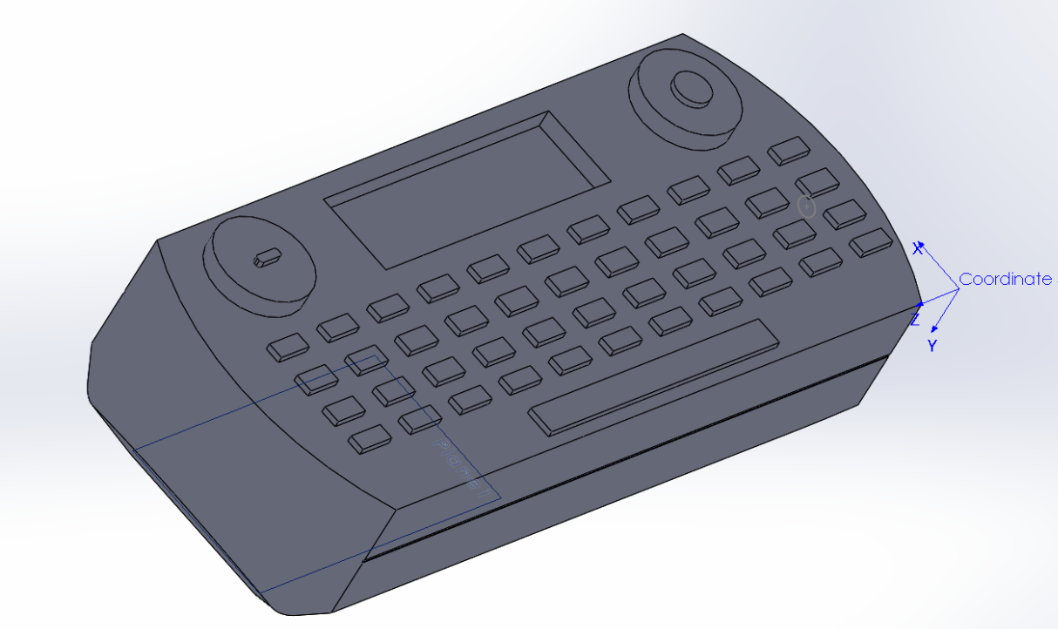
SMART REMoTE as the solution

Slide 4
Functions of the smart remote
Instead of using AI voice control, user may use the smart remote to control the system in the house.
With this approach, smart home system will still can be used if there is no internet connection
The house system can be controlled by the remote control

Slide 5
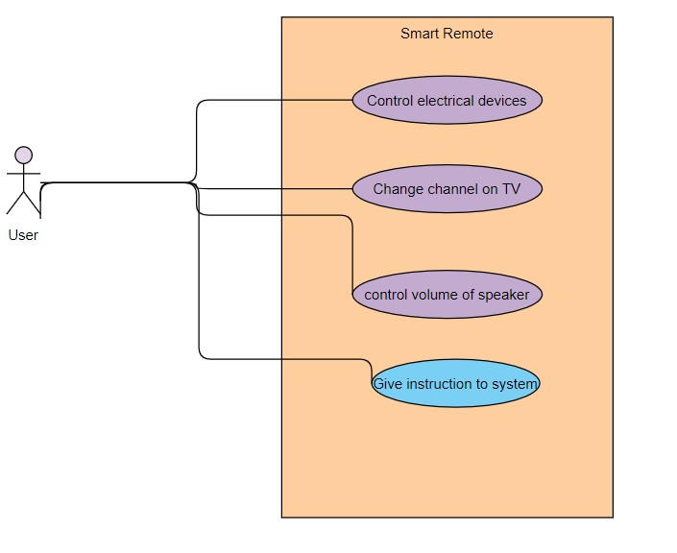
Use case diagram for smart remote

Slide 6
Challenges of making the first prototype
There might be possibility in interrupting devices while controlling it.
The production cost may be a bit expensive for a start up

Slide 7
Requirement of Smart Remote
Using wireless communication
Gesture Control Operation
Need lots of sensors.

Slide 8
THANK YOU

